Slide 1
Murach’s PHP and MySQL (4th Edition)
Chapter 2
How to code
a PHP application

Slide 2
Objectives (part 1)
Applied
Given the specifications for a PHP application that requires only the skills and language elements presented in this chapter, code, test, and debug the application. That includes these skills:
Creating variables with valid names and assigning values to them
Using literals and concatenating strings
Using the built-in $_GET and $_POST arrays
Using echo statements to display data on a page
Coding string and numeric expressions
Using compound assignment operators
Using the built-in intdiv(), number_format(), date(), isset(), empty(), and is_numeric() functions

Slide 3
Objectives (part 2)
Using the htmlspecialchars() function to escape special characters on a page
Using the filter_input() function to filter input from the $_GET and $_POST arrays
Coding conditional expressions
Coding if, while, and for statements
Using built-in functions like include(), include_once(), require(), and require_once() to pass control to another page
Access and use the online PHP documentation.

Slide 4
Objectives (part 3)
Knowledge
Explain how PHP is embedded within an HTML document.
Distinguish between PHP statements and comments.
Describe these PHP data types: integer, double, Boolean, and string.
List the rules for creating a PHP variable name.
Describe the code for declaring a variable and assigning a value to it.
Describe the use of the built-in $_GET and $_POST arrays.
Describe the use of the echo statement.
Describe the rules for evaluating an arithmetic expression, including order of precedence and the use of parentheses.

Slide 5
Objectives (part 4)
Describe the use of these built-in functions: intdiv(), number_format(), date(), isset(), is_numeric(), include(), include_once(), require(), and require_once().
Describe how an XSS attack works and how to protect against this type of attack.
Describe the rules for evaluating a conditional expression, including order of precedence and the use of parentheses.
Describe the flow of control of an if, while, or for statement.

Slide 6
A PHP file that includes HTML and embedded PHP
<?php
// get the data from the request
$first_name = $_GET['first_name'];
$last_name = $_GET['last_name'];
?>
<!DOCTYPE html>
<html>
<head>
<title>Name Test</title>
<link rel="stylesheet" href="main.css">
</head>
<body>
<h2>Welcome</h2>
<p>First name: <?php echo $first_name; ?></p>
<p>Last name: <?php echo $last_name; ?></p>
</body>
</html>

Slide 7
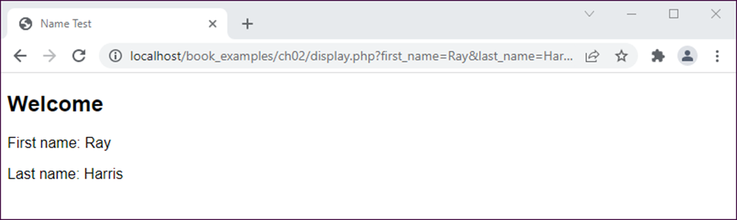
The PHP file displayed in a browser

Slide 8
PHP code: comments and statements
<?php
/*********************************************
* This program calculates the discount for a
* price that's entered by the user
********************************************/
// get the data from the form
$list_price = $_GET['list_price'];
// calculate the discount
$discount_percent = .20; // 20% discount
$discount_amount = $list_price * $discount_percent;
$discount_price = $list_price - $discount_amount;
?>
Another way to code single-line comments
# calculate the discount
$discount_percent = .20; # 20% discount

Slide 9
Syntax rules
PHP statements end with a semicolon.
PHP ignores extra whitespace in statements.

Slide 10
The six PHP data types
integer
double
boolean
string
array
object

Slide 11
Integer values (whole numbers)
15 // an integer
-21 // a negative integer
Double values (numbers with decimal positions)
21.5 // a floating-point value
-124.82 // a negative floating-point value
The two Boolean values
true // equivalent to true, yes, on, or 1
false // equivalent to false, no, off, or 0
String values
'Ray Harris' // a string with single quotes
"Ray Harris" // a string with double quotes
'' // an empty string
null // a NULL value

Slide 12
Double values that use scientific notation
3.7e9 // equivalent to 3700000000
3.7e-9 // equivalent to 0.0000000037
-3.7e9 // equivalent to -3700000000

Slide 13
Using the assignment operator (=) as you declare a variable and give it a value
$count = 10; // an integer literal
$list_price = 9.50; // a double literal
$first_name = 'Bob'; // a string literal
$first_name = "Bob"; // a string literal
$is_valid = false; // a Boolean literal
$product_count = $count; // $product_count is 10
$price = $list_price; // $price is 9.50
$name = $first_name; // $name is "Bob"
$is_new = $is_valid; // $is_new is FALSE

Slide 14
Rules for creating variable names
Variable names are case-sensitive.
Variable names can contain letters, numbers, and underscores.
Variable names can’t contain special characters.
Variable names can’t begin with a digit or two underscores.
Variable names can’t use names that are reserved by PHP, such as the variable named $this that’s reserved for use with objects.

Slide 15
How to declare a constant
define('MAX_QTY', 100); // an integer constant
define('PI', 3.14159265); // a double constant
define('MALE', 'm'); // a string constant

Slide 16
An HTML form that does an HTTP GET request
<form action="display.php" method="get">
<label>First name: </label>
<input type="text" name="first_name"/><br>
<label>Last name: </label>
<input type="text" name="last_name"/><br>
<label>&nbsp;</label>
<input type="submit" value="Submit"/>
</form>
The URL for the HTTP GET request
//localhost/.../display.php?first_name=Ray&last_name=Harris
Getting the data and storing it in variables
$first_name = $_GET['first_name'];
$last_name = $_GET['last_name'];

Slide 17
An <a> tag that performs an HTTP GET request
<a href="display.php?first_name=Ray&last_name=Harris">
Display Name
</a>

Slide 18
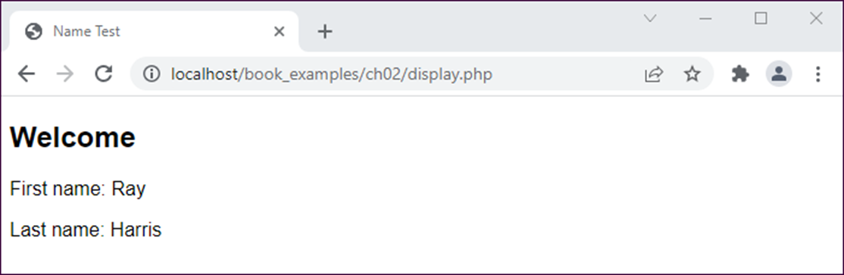
A PHP page for an HTTP POST request
An HTML form that specifies the POST method
<form action="display.php" method="post">
Code that gets the data from the $_POST array
$first_name = $_POST['first_name'];
$last_name = $_POST['last_name'];

Slide 19
When to use the HTTP GET method
When the request is for a page that gets data from a database server.
When the request can be executed multiple times without causing any problems.

Slide 20
When to use the HTTP POST method
When the request is for a page that writes data to a database server.
When executing the request multiple times may cause problems.
When you don’t want to include the parameters in the URL for security reasons.
When you don’t want users to be able to include parameters when they bookmark a page.
When you need to transfer more than 4 KB of data.

Slide 21
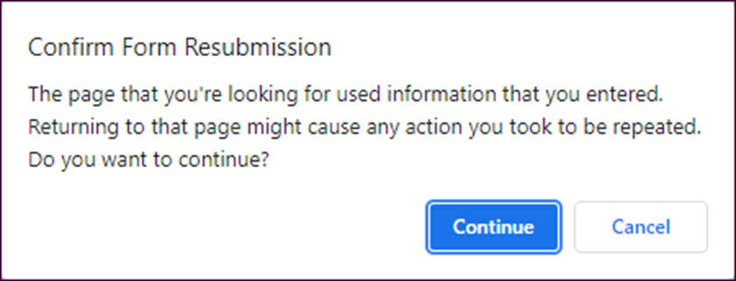
The Chrome dialog box that’s displayed if the user tries to refresh a post

Slide 22
How to assign string expressions
Use single quotes to improve PHP efficiency
$first_name = 'Bob';
$last_name = 'Roberts';
Assign NULL values and empty strings
$address2 = ''; // an empty string
$address2 = null; // a NULL value
Use double quotes to insert a variable into a string
$name = "Name: $first_name"; // Name: Bob
$name = "$first_name $last_name"; // Bob Roberts
Use single and double quotes for special purposes
$last_name = "O'Brien"; // O'Brien
$line = 'She said, "Hi."'; // She said, "Hi."

Slide 23
How to use the concatenation operator (.)
For simple joins
$first_name = 'Bob';
$last_name = 'Roberts';
$name = 'Name: ' . $first_name; // Name: Bob
$name = $first_name . ' ' . $last_name; // Bob Roberts
To join a number to a string
$price = 19.99;
$price_string = 'Price: ' . $price; // Price: 19.99

Slide 24
The syntax for the echo statement
echo string_expression;
How to use an echo statement within HTML
<p>Name: <?php echo $name; ?></p>
How to use an echo statement
with the htmlspecialchars() function
<p>Name: <?php echo htmlspecialchars($name); ?></p>

Slide 25
Common arithmetic operators
Operator | Description | Example | Result
+ | Addition | 5 + 7 | 12
- | Subtraction | 5 - 12 | -7
* | Multiplication | 6 * 7 | 42
/ | Division | 13 / 4 | 3.25
% | Modulus | 13 % 4 | 1
++ | Increment | $counter++ | adds 1 to counter
-- | Decrement | $counter-- | subtracts 1 from counter

Slide 26
Some simple numeric expressions
$x = 14;
$y = 8;
$result = $x + $y; // 22
$result = $x - $y; // 6
$result = $x * $y; // 112
$result = $x / $y; // 1.75
$result = $x % $y; // 6
$x++; // 15
$y--; // 7
A statement that uses the intdiv() function
(PHP 7 and later)
$result = intdiv($x, $y); // 2

Slide 27
Statements that calculate a discount
$list_price = 19.95;
$discount_percent = 20;
$discount_amount = $list_price * $discount_percent * .01;
$discount_price = $list_price - $discount_amount;

Slide 28
The order of precedence
Order | Operators | Direction
1 | ++ | Left to right
2 | -- | Left to right
3 | * / % | Left to right
4 | + - | Left to right
Order of precedence and the use of parentheses
3 + 4 * 5 // 23
(3 + 4) * 5 // 35

Slide 29
The compound assignment operators
.=
+=
-=
*=
/=
%=

Slide 30
Two ways to append string data to a variable
The standard assignment operator
$name = 'Ray ';
$name = $name . 'Harris'; // 'Ray Harris'
A compound assignment operator
$name = 'Ray ';
$name .= 'Harris'; // 'Ray Harris'

Slide 31
Three ways to increment a counter variable
The standard assignment operator
$count = 1;
$count = $count + 1; // 2
The compound assignment operator
$count = 1;
$count += 1; // 2
The increment operator
$count = 1;
$count++; // 2

Slide 32
More examples of compound assignment
How to append numeric data to a string variable
$message = 'Months: ';
$months = 120;
$message .= $months; // 'Months: 120'
How to work with numeric data
$subtotal = 24.50;
$subtotal += 75.50; // 100
$subtotal *= .9; // 90 (100 * .9)

Slide 33
A function for formatting numbers
number_format($number [, $decimals])
Statements that format numbers
$nf = number_format(12345); // 12,345
$nf = number_format(12345, 2); // 12,345.00
$nf = number_format(12345.674, 2); // 12,345.67
$nf = number_format(12345.675, 2); // 12,345.68

Slide 34
A function for getting the current date
date($format)
Commonly used characters for date formatting
Character | Description
Y | A four-digit year such as 2010.
y | A two-digit year such as 10.
m | Numeric representation of the month with leading zeros (01-12).
d | Numeric representation of the day of the month with leading zeros (01-31).

Slide 35
Statements that format a date
$date = date('Y-m-d'); // 2022-04-12
$date = date('m/d/y'); // 04/12/22
$date = date('m.d.Y'); // 04.12.2022
$date = date('Y'); // 2022

Slide 36
Three functions for checking variable values
isset($var)
empty($var)
is_numeric($var)
Function calls that check variable values
isset($name) // TRUE if $name has been set
// and is not NULL
empty($name) // TRUE if $name is empty
is_numeric($price) // TRUE if $price is a number

Slide 37
Two functions for converting user-entered data for display
Name | Description
htmlspecialchars($string) | Converts certain HTML special characters (&, ', ", <, and >) to their corresponding HTML entities and returns the resulting string.
htmlentities($string) | Converts all HTML characters that have corresponding HTML entities and returns the resulting string.

Slide 38
The filter_input() function
Name | Description
filter_input($type, $variable_name [, $filter]) | Gets a value from a superglobal variable and optionally filters it. Returns the requested value on success, a FALSE value if the filter fails, or a NULL value if the requested value is not set.
The three arguments
Name | Description
type | Specifies the superglobal variable to access. Common values include INPUT_GET, INPUT_POST, and INPUT_COOKIE.
variable_name | The name of the value to retrieve.
filter | Optional. The constant for the filter to apply.

Slide 39
Common constants for filters
Name | Description
FILTER_VALIDATE_INT | Validates an integer value.
FILTER_VALIDATE_FLOAT | Validates a floating-point (double) value.
FILTER_VALIDATE_EMAIL | Validates an email address.
FILTER_VALIDATE_URL | Validates a URL.
FILTER_VALIDATE_BOOLEAN | Returns a TRUE value for “1”, “true”, “on”, or “yes”. Otherwise, it returns a FALSE value.

Slide 40
Statements that retrieve values from the superglobal variables
$product_description = filter_input(INPUT_GET, 'product_description');
// NULL if 'product_description' has not been set
// in the $_GET array
$investment = filter_input(INPUT_POST, 'investment',
FILTER_VALIDATE_FLOAT);
// NULL if 'investment' has not been set
// in the $_POST array
// FALSE if 'investment' is not a valid float value
$years = filter_input(INPUT_POST, 'years',
FILTER_VALIDATE_INT);
// NULL if 'years' has not been set in the $_POST array
// FALSE if 'years' is not a valid integer value

Slide 41
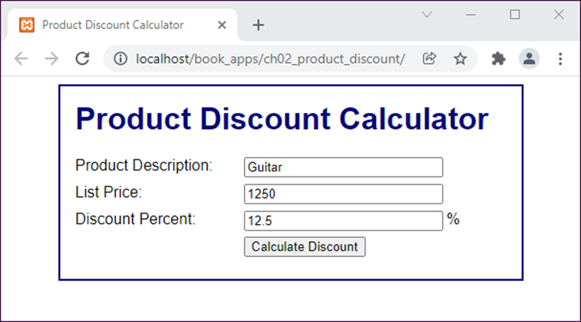
The first page (index.html)

Slide 42
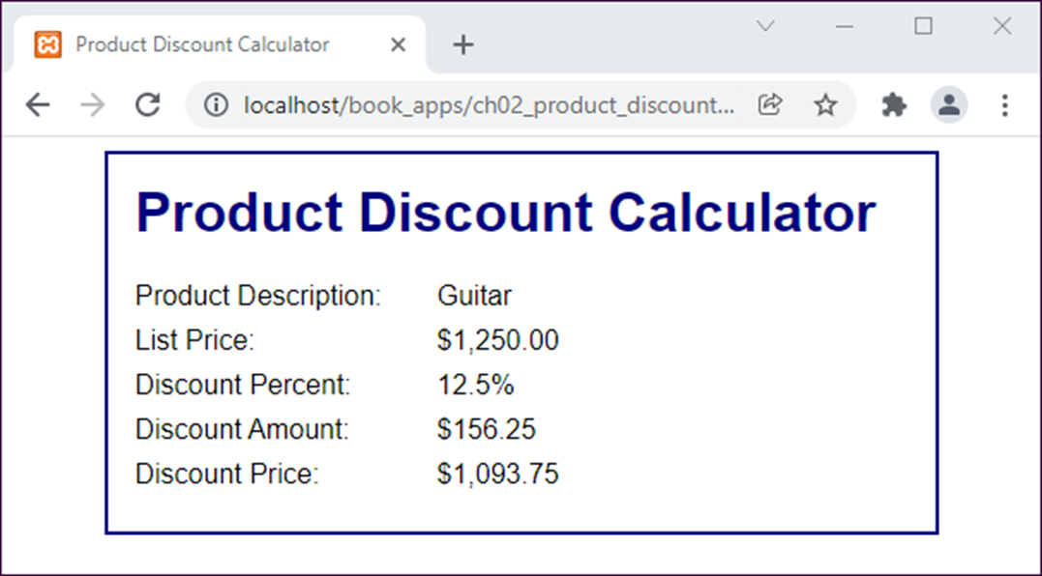
The second page (product_discount.php)

Slide 43
The code for the form on the first page
<form action="display_discount.php" method="post">
<div id="data">
<label>Product Description:</label>
<input type="text"
name="product_description"><br>
<label>List Price:</label>
<input type="text" name="list_price"><br>
<label>Discount Percent:</label>
<input type="text" name="discount_percent">
<span>%</span><br>
</div>
<div id="buttons">
<label>&nbsp;</label>
<input type="submit" value="Calculate Discount">
<br>
</div>
</form>

Slide 44
The PHP file (display_discount.php) (part 1)
<?php
// get the data from the form
$product_description =
filter_input(INPUT_POST, 'product_description');
$list_price = filter_input(INPUT_POST, 'list_price');
$discount_percent =
filter_input(INPUT_POST, 'discount_percent');
// calculate the discount and discounted price
$discount = $list_price * $discount_percent * .01;
$discount_price = $list_price - $discount;
// apply formatting to dollar and percent amounts
$list_price_f = "$".number_format($list_price, 2);
$discount_percent_f = $discount_percent."%";
$discount_f = "$".number_format($discount, 2);
$discount_price_f =
"$".number_format($discount_price, 2);
?>

Slide 45
The PHP file (display_discount.php) (part 2)
<!DOCTYPE html>
<html>
<head>
<title>Product Discount Calculator</title>
<link rel="stylesheet" href="main.css">
</head>
<body>
<main>
<h1>Product Discount Calculator</h1>
<label>Product Description:</label>
<span><?php echo
htmlspecialchars($product_description); ?>
</span>
<br>

Slide 46
The PHP file (display_discount.php) (part 3)
<label>List Price:</label>
<span><?php echo $list_price_f; ?></span>
<br>
<label>Discount Percent:</label>
<span><?php echo $discount_percent_f; ?></span>
<br>
<label>Discount Amount:</label>
<span><?php echo $discount_f; ?></span>
<br>
<label>Discount Price:</label>
<span><?php echo $discount_price_f; ?></span>
<br>
</main>
</body>
</html>

Slide 47
The relational operators
Operator | Example
== | $last_name == "Harris" $test_score == 10
!= | $first_name != "Ray" $months != 0
< | $age < 18
<= | $investment <= 0
> | $test_score > 100
>= | $rate / 100 >= 0.1
=== | $investment === FALSE $years === NULL
!== | $investment !== FALSE $years !== NULL

Slide 48
The logical operators in order of precedence
Operator | Example
! | !is_numeric($age)
&& | $age > 17 && $score < 70
|| | !is_numeric($rate) || $rate < 0

Slide 49
An if statement with just an if clause
if ( $price <= 0 ) {
$message = 'Price must be greater than zero.';
}
An if statement with an else clause
if ( empty($first_name) ) {
$message = 'You must enter your first name.';
} else {
$message = 'Hello ' . $first_name . '!';
}

Slide 50
An if statement with else if and else clauses
if ( empty($investment) ) {
$message = 'Investment is a required field.';
} else if ( !is_numeric($investment) ) {
$message = 'Investment must be a valid number.';
} else if ( $investment <= 0 ) {
$message = 'Investment must be greater than zero.';
} else {
$message = 'Investment is valid!';
}

Slide 51
A compound conditional expression
if ( empty($investment) || !is_numeric($investment)
|| $investment <= 0 ) {
$message =
'Investment must be a valid number > zero.';
}
Nested if statements
if ( empty($months) || !is_numeric($months)
|| $months <= 0 ) {
$message = 'Please enter a number of months > zero.';
} else {
$years = $months / 12;
if ( $years > 1 ) {
$message = 'A long-term investment.';
} else {
$message = 'A short-term investment.';
}
}

Slide 52
A while loop that stores the numbers 1 through 5
$counter = 1;
while ($counter <= 5) {
$message = $message . $counter . '|';
$counter++;
}
// $message = 1|2|3|4|5|

Slide 53
A for loop that stores the numbers 1 through 5
for ($counter = 1; $counter <= 5; $counter++) {
$message = $message . $counter . '|';
}
// $message = 1|2|3|4|5|

Slide 54
A while loop that calculates the future value of a one-time investment
$investment = 1000;
$interest_rate = .1;
$years = 25;
$future_value = $investment;
$i = 1;
while ($i <= $years) {
$future_value += $future_value * $interest_rate;
$i++;
}

Slide 55
A for loop that calculates the future value of a one-time investment
$investment = 1000;
$interest_rate = .1;
$years = 25;
$future_value = $investment;
for ($i = 1; $i <= $years; $i++) {
$future_value += $future_value * $interest_rate;
}

Slide 56
Built-in functions that pass control
include($path)
include_once($path)
require($path)
require_once($path)
exit([$status])
die([$status])

Slide 57
The include function
include 'index.php'; // parentheses are optional
include('index.php'); // index.php in the current
// directory
The require function
require('index.php'); // index.php in the current
// directory
The exit function
exit; // parentheses are optional
exit();
exit('Unable to connect to DB.');
// passes a message to the browser

Slide 58
How to pass control to another PHP file in the current directory
if ($is_valid) {
include('process_data.php');
exit();
}
How to navigate up and down directories
include('view/header.php'); // down one directory
include('./error.php'); // in the current directory
include('../error.php'); // up one directory
include('../../error.php'); // up two directories

Slide 59
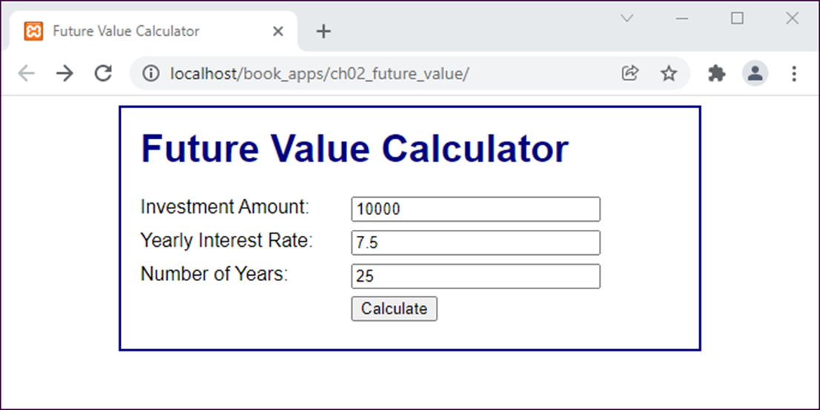
The first page of the Future Value application

Slide 60
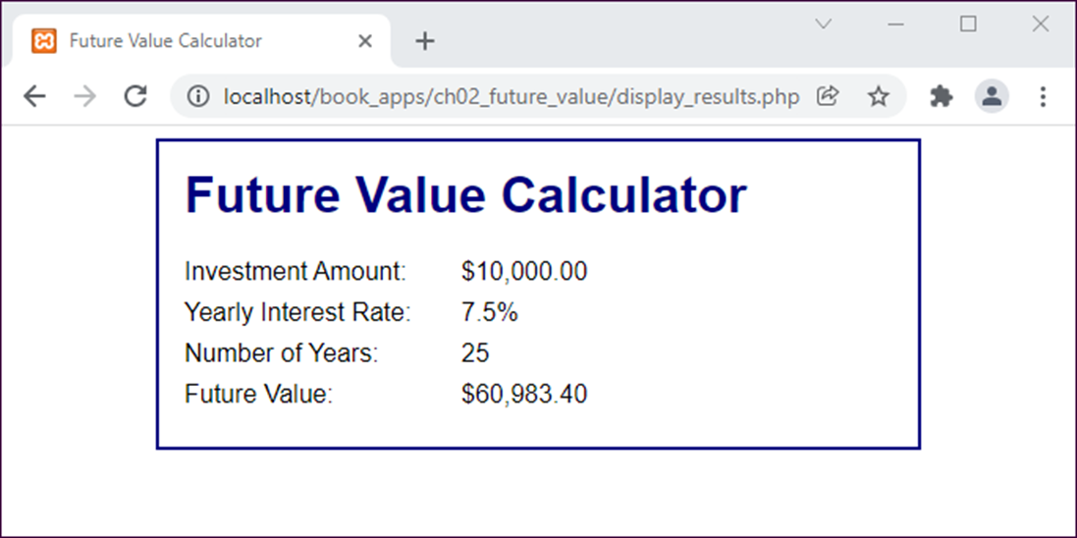
The second page of the Future Value application

Slide 61
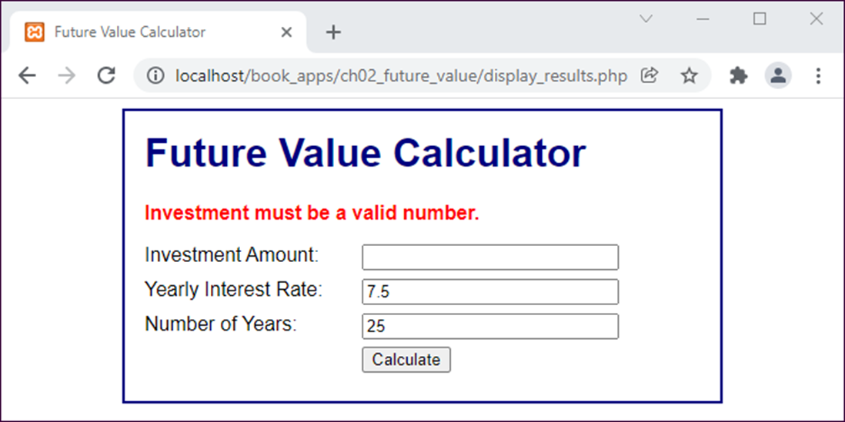
The first page with an error message

Slide 62
The index.php file (part 1)
<?php
//set default value of variables for initial page load
if (!isset($investment)) { $investment = ''; }
if (!isset($interest_rate)) { $interest_rate = ''; }
if (!isset($years)) { $years = ''; }
?>
<!DOCTYPE html>
<html>
<head>
<title>Future Value Calculator</title>
<link rel="stylesheet" href="main.css">
</head>
<body>
<main>
<h1>Future Value Calculator</h1>
<?php if (!empty($error_message)) { ?>
<p class="error">
<?php echo htmlspecialchars($error_message); ?>
</p>
<?php } ?>

Slide 63
The index.php file (part 2)
<form action="display_results.php" method="post">
<div id="data">
<label>Investment Amount:</label>
<input type="text" name="investment"
value="<?php echo htmlspecialchars($investment); ?>">
<br>
<label>Yearly Interest Rate:</label>
<input type="text" name="interest_rate"
value="<?php echo htmlspecialchars($interest_rate); ?>">
<br>
<label>Number of Years:</label>
<input type="text" name="years"
value="<?php echo htmlspecialchars($years); ?>">
<br>
</div>

Slide 64
The index.php file (part 3)
<div id="buttons">
<label>&nbsp;</label>
<input type="submit" value="Calculate"><br>
</div>
</form>
</main>
</body>
</html>

Slide 65
The display_results.php file (part 1)
<?php
// get the data from the form
$investment = filter_input(INPUT_POST, 'investment',
FILTER_VALIDATE_FLOAT);
$interest_rate = filter_input(INPUT_POST,
'interest_rate', FILTER_VALIDATE_FLOAT);
$years = filter_input(INPUT_POST, 'years',
FILTER_VALIDATE_INT);
// validate data
$error_message = '';
// validate investment
if ( $investment === FALSE ) {
$error_message .=
'Investment must be a valid number.<br>';
} else if ( $investment <= 0 ) {
$error_message .=
'Investment must be greater than zero.<br>';
}

Slide 66
The display_results.php file (part 2)
// validate interest rate
if ( $interest_rate === FALSE ) {
$error_message .=
'Interest rate must be a valid number.<br>';
} else if ( $interest_rate <= 0 ) {
$error_message .=
'Interest rate must be greater than zero.<br>';
}
// validate years
if ( $years === FALSE ) {
$error_message .=
'Years must be a valid whole number.<br>';
} else if ( $years <= 0 ) {
$error_message .=
'Years must be greater than zero.<br>';
} else if ( $years > 30 ) {
$error_message .=
'Years must be less than 31.<br>';
}

Slide 67
The display_results.php file (part 3)
// if an error message exists, go to the index page
if ( $error_message != '' ) {
include('index.php');
exit();
}
// calculate the future value
$future_value = $investment;
for ($i = 1; $i <= $years; $i++) {
$future_value = $future_value +
($future_value * $interest_rate * .01);
}
// apply currency and percent formatting
$investment_f = '$'.number_format($investment, 2);
$yearly_rate_f = $interest_rate.'%';
$future_value_f = '$'.number_format($future_value, 2);
?>

Slide 68
The display_results.php file (part 4)
<!DOCTYPE html>
<html>
<head>
<title>Future Value Calculator</title>
<link rel="stylesheet" href="main.css">
</head>
<body>
<main>
<h1>Future Value Calculator</h1>
<label>Investment Amount:</label>
<span><?php echo $investment_f; ?></span><br>
<label>Yearly Interest Rate:</label>
<span><?php echo $yearly_rate_f; ?></span><br>
<label>Number of Years:</label>
<span><?php echo $years; ?></span><br>
<label>Future Value:</label>
<span><?php echo $future_value_f; ?></span><br>
</main>
</body>
</html>

Slide 69
The URL for the PHP documentation
http://php.net/docs.php

Slide 70
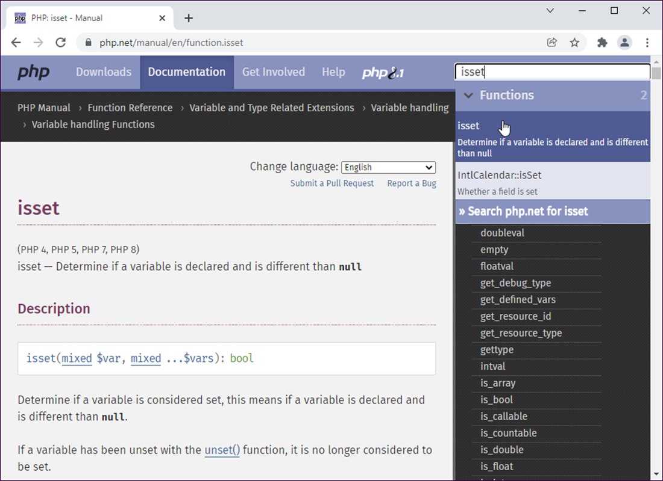
Documentation for the isset() function

Slide 71
How to access the PHP documentation
On the first page of the website, click on the name of the language that you want to use. That will access the first page of the PHP manual, which includes a table of contents.
How to use the PHP documentation
Scroll down the contents until you find the link you’re looking for, click on it, and continue this process until the right information is displayed.
As you display information, you can use the links in the right pane of the window to display other topics at the same level.
How to find the documentation for a function when you know its name
Type the function name in the Search text box and then select from the autocomplete list.

